Slide 1
Front-End Developer 36 – 12.05.2018
Radovan Ostojić

Slide 2
Sadržaj časa
Git
Osnove
GitHub
Git Feature Branch Workflow
Preporuke za citanje – poseban folder u okviru sesije 36

Slide 3

Ponavljanje je majka znanja ☺
sessionStorage
localStorage
Baze podataka

Slide 4
Git

Slide 5
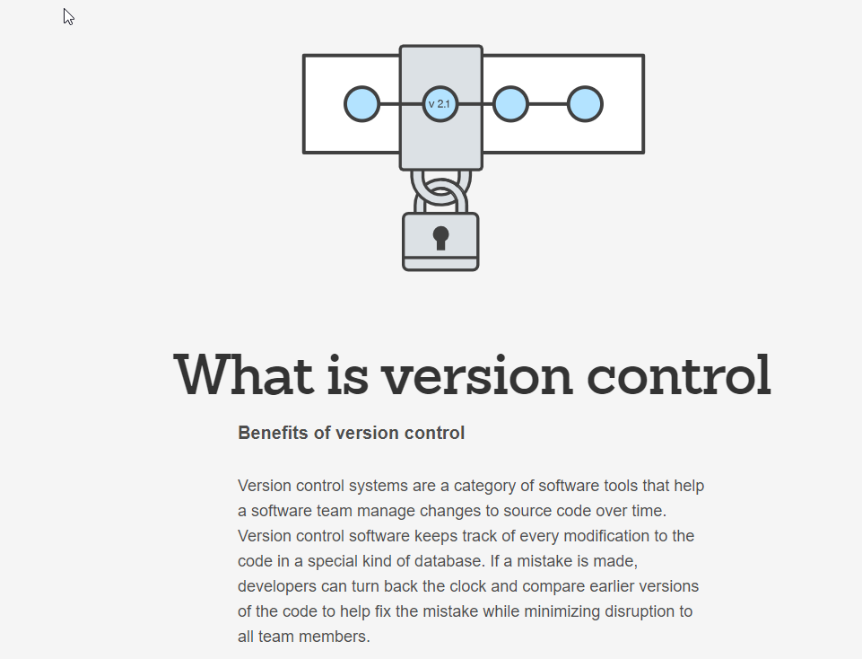
Istorija i znacenja

Slide 6
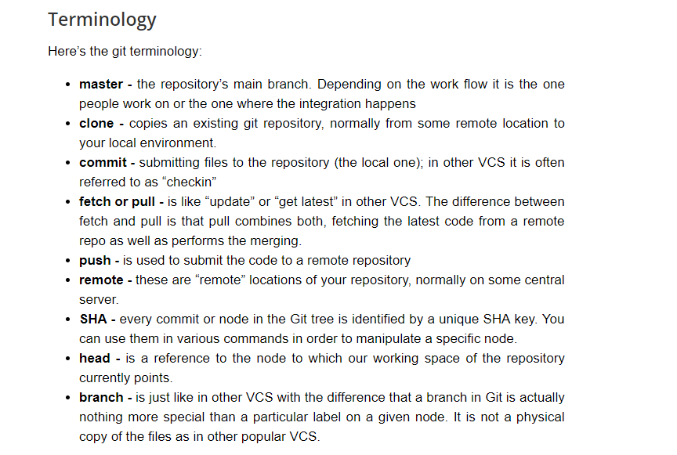
Terminologija

Slide 7
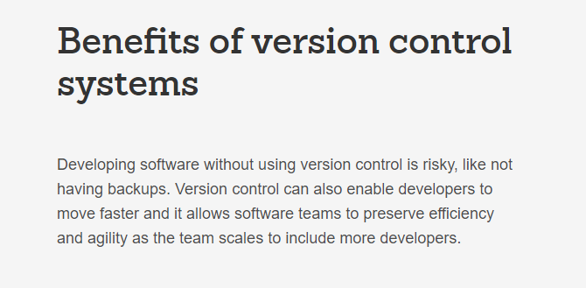
Benefiti

Slide 8
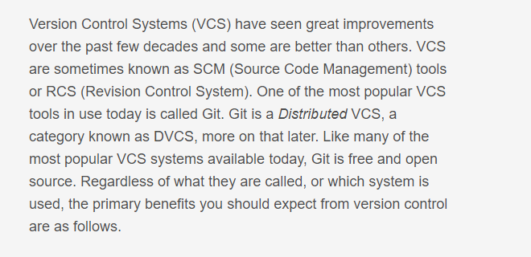
Benefiti

Slide 9
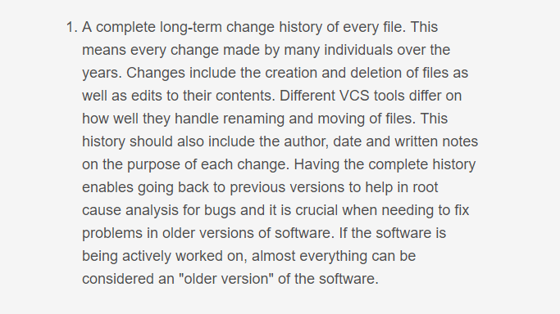
Benefit 1

Slide 10
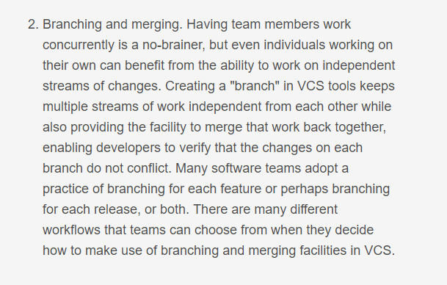
Benefit 2

Slide 11
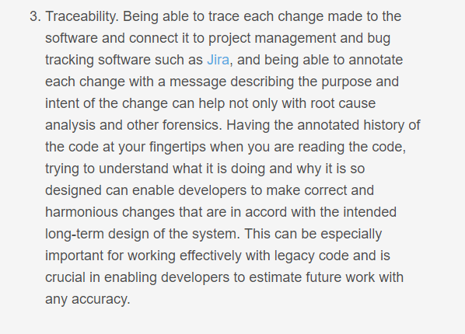
Benefit 3

Slide 12
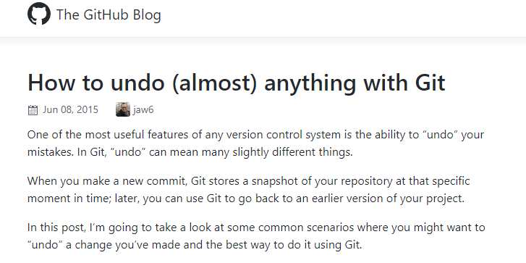
Preporuka – kako se radi undo?
https://blog.github.com/2015-06-08-how-to-undo-almost-anything-with-git/

Slide 13
Coding Challenge 1
https://guides.github.com/activities/hello-world/

Slide 14
Coding Challenge 2
https://try.github.io/levels/1/challenges/1

